Slide 1

Simplify your life: declutter-prepare-move
BLAIR BRYANT-CERTIFIED SENIOR ADVISOR, DESIGNATED BROKER
Notes:
Paralized homeowners. Planning – whether you are moving in 3 months or 5 years, starting the conversations now will make the whole process so much easier in the long run.

Slide 2
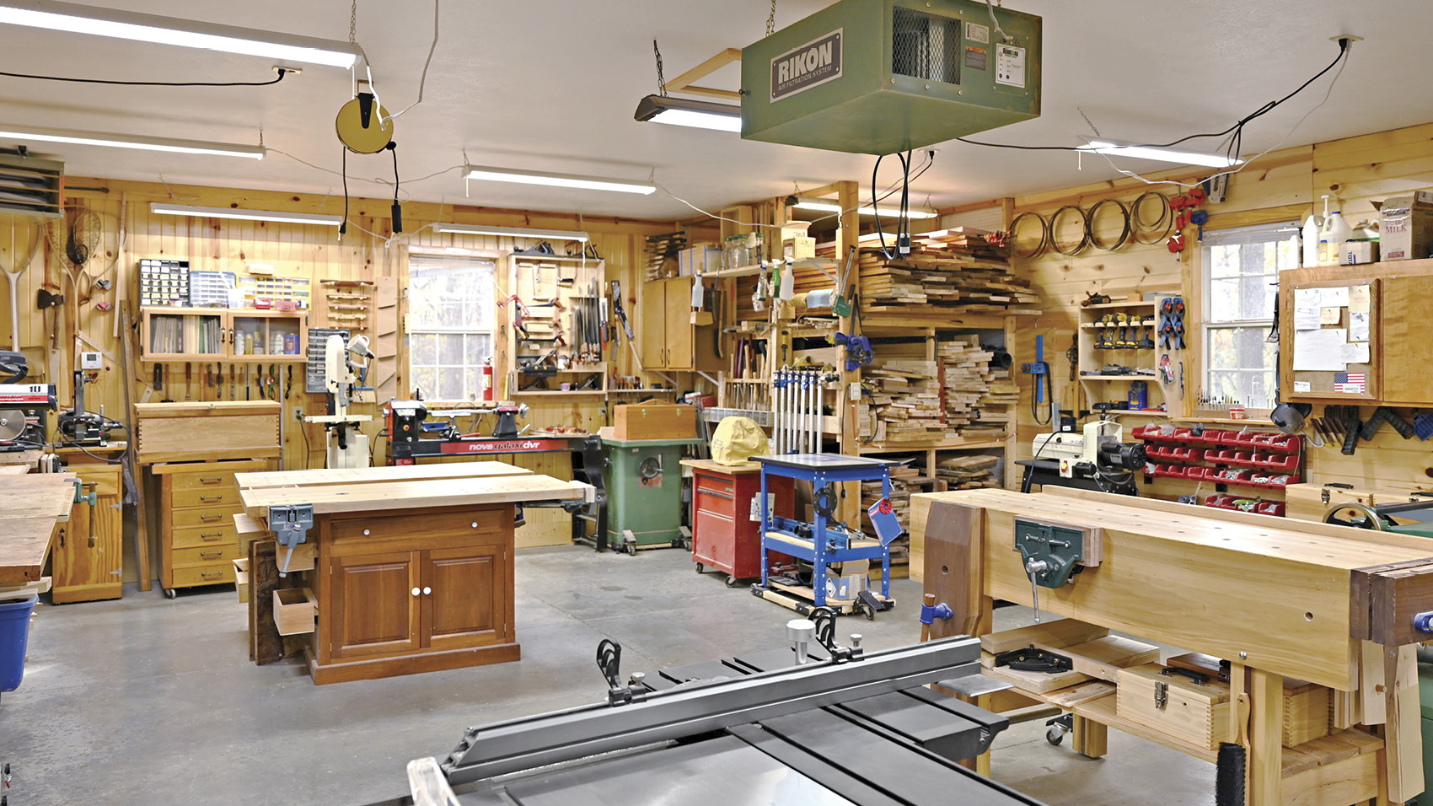

Slide 3
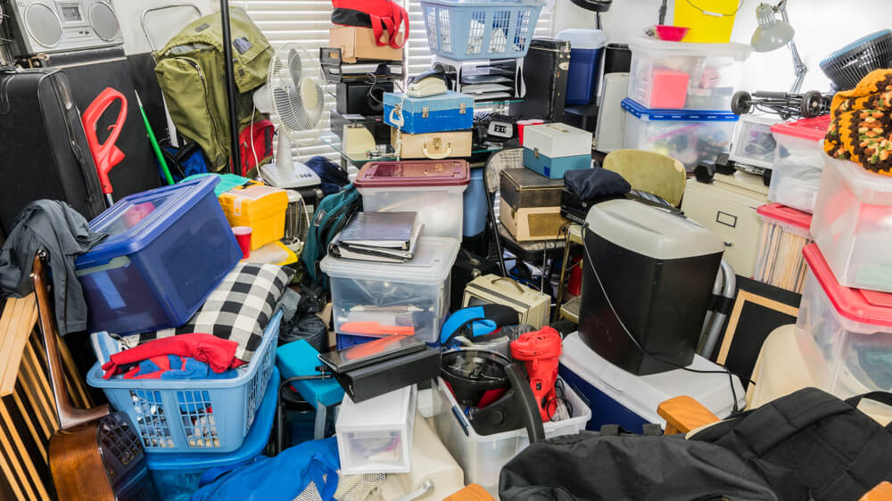

Slide 4


Slide 5
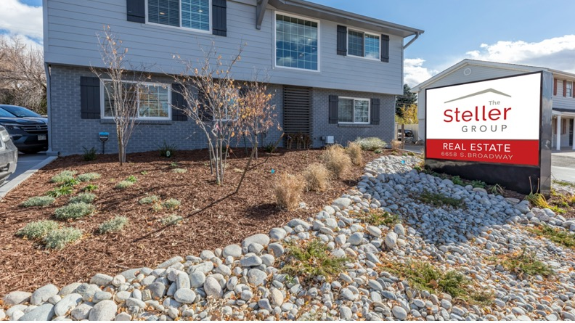

Slide 6
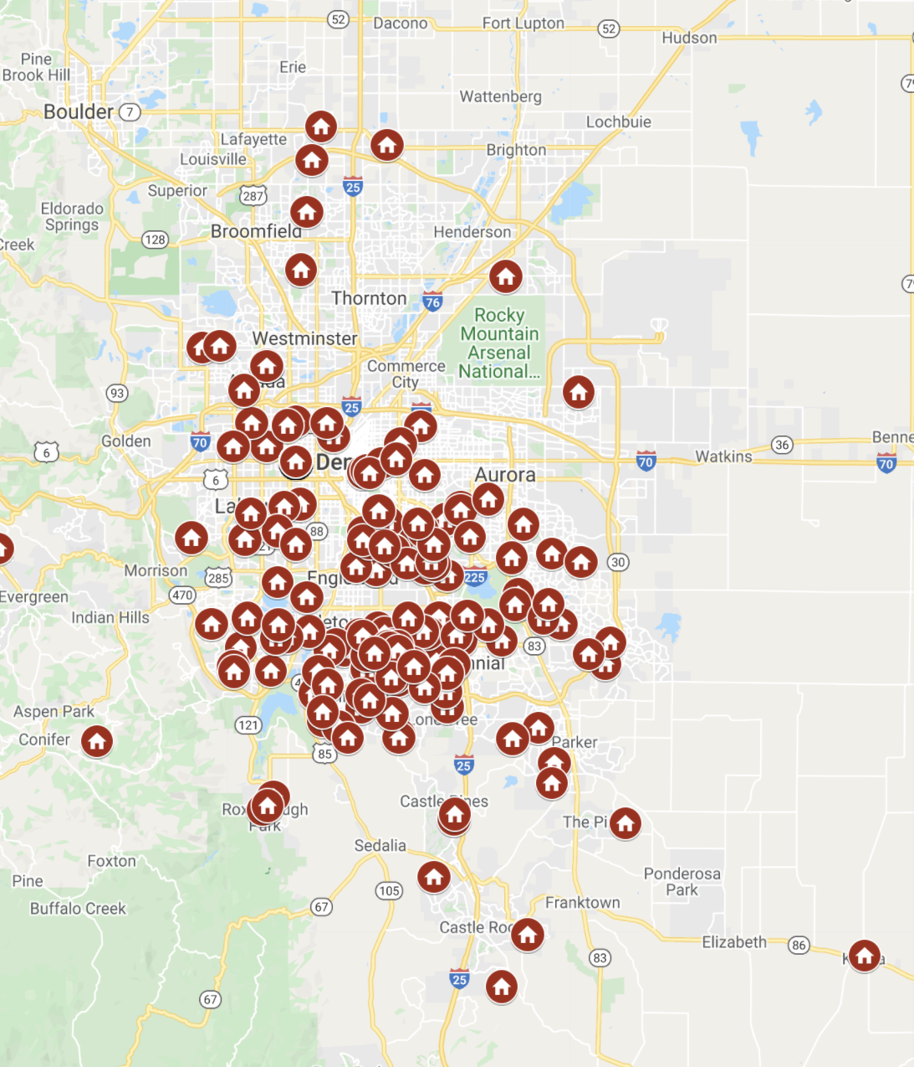
Steller downsizing and move solutions
DOWNSIZING COORDINATION
  ESTATE SALES AND CLEAN-OUTS
RENOVATION SERVICES
  PRE-LISTING IMPROVEMENTS
STAGING AND MARKETING SERVICES
SENIOR REAL ESTATE SPECIALIST

Slide 7


Blair Bryant-realtor, Director of senior services
Designated Broker and Director of Senior Services-Steller Real Estate
Former Educator, Choral Music Education
Raised in South Florida and moved to Colorado 1994
Bachelor’s CU-Boulder, Master’s Florida State University

Slide 8
Downsizing Moves are Different
House
Timing
Stuff

Slide 9

Two Big Decisions
What do I do with all my stuff?
Where would I move?

Slide 10
downsizing

Slide 11
HOW WE GOT HERE
Your stuff-your kids stuff-your parents stuff…….
Generational Shift
Charities are overwhelmed
“Don’t throw anything away”
Memories

Slide 12

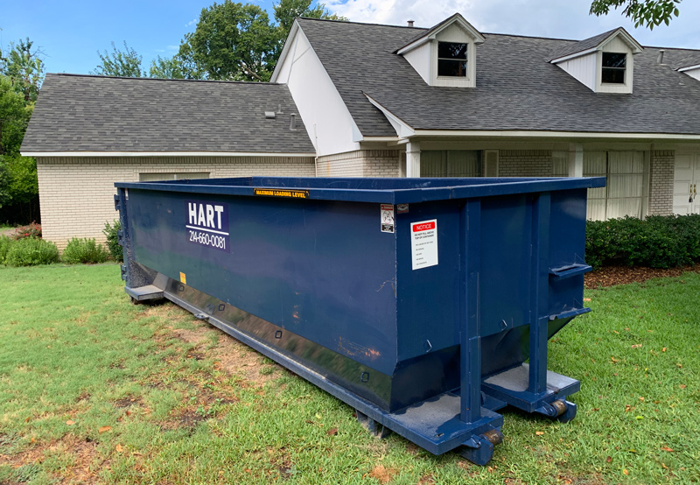
THREE
Strategies for downsizing
1. Rip Off the Band-Aid
  Labor Intensive
  Wasteful
  Painful

Slide 13

THREE
Strategies for downsizing
2. The Ostrich
  Procrastinate
  Kids and grandkids left to deal with it
  Emotional

Slide 14

THREE
Strategies for downsizing
3. Mindful downsizing
  Educate
  Employ a strategy
  Set timelines

Slide 15
Sell
On-Line
Donate
Charity
Trash
Weekly
Consign
Estate Sale
Give Away
Gift
Seasonal
Pay

Slide 16

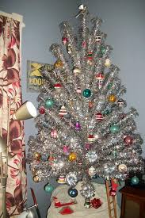

WHAT’S HOT
Mid-modern 1950s Scandinavian
Vintage holiday
Vintage Toys
Bohemian wall hangings
Farmhouse-inspired
Copper

Slide 17



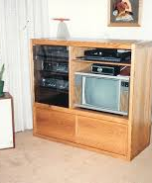
WHAT’S NOT
Antiques
China
Hummels
Oak furniture
Plated silver
Southwest décor
Asian-inspired
Crystal/cut glass
Entertainment centers
Desk systems

Slide 18

Getting Started
Timeline will dictate priorities
  2+ Years, 1 Year, 6 Months
Go shopping in your own home
Set timelines with family
3 hour rule
Trash Provider-Recycling Provider
Treasures-Trinkets-Forgotten Items-Malignant Items
Blue-Keep
Yellow-Family
Trash

Slide 19


OTHER SERVICES
TO REMEMBER
Paint recycling (5-gallon limit)
Chemical round-up
Shredding services
Computers/monitors
Firearms
Medication drop-off
Pickupplease.org

Slide 20
What Housing Options are Available?

Slide 21


Slide 22

What does your ideal next home look like?
Layout
  Main Level Living
  No stairs
Ownership or Renting
No Maintenance to Low Maintenance
Age Restricted
Lifestyle, CCRC, or Rightsizing

Slide 23
55+ Purchase
Age Restricted
Lifestyle Rental
Cooperatives
Continuing Care Retirement Communities
55+ Downsizing Options

Slide 24

All-in-One
Downsizing
Declutter
Stuff
Strategy
Prepare
Where to move
House Value
Move
Time of Sale
Staging
Timeline
Pre-Listing Improvements

Slide 25


The Steller Group
Senior Real Estate Specialist &
Certified Senior Advisor
Blair Bryant
Free home value evaluation
Short-term home consult
Denverseniorseminars.com
Get in touch:
720.593.9355
StellerRealEstate.com

